Slide 1


🏠 Predicting House Prices Using Regression Models
An End-to-End Machine Learning Project with Real Estate Data.
by Harshal John Robson

Slide 2

Project Objective
Goal
Predict house prices from physical and locational features using regression.
Key Questions
Which features impact price most?
Which regression model offers top accuracy?
Can regularization and polynomial transforms help?

Slide 3
Data Overview
Dataset: King County House Sales, Seattle
Missing Values Handling
Source: IBM Developer Skills Network
bedrooms and bathrooms missing values replaced with mean.
Size: ~21,600 entries, 21 features
Target Variable: price
Features: sqft_living, bedrooms, bathrooms, lat, grade, waterfront, etc.

Slide 4
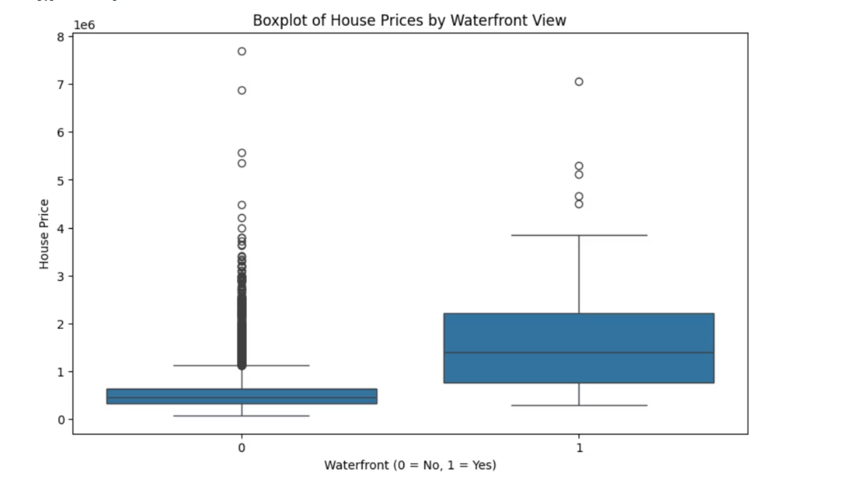

Slide 5

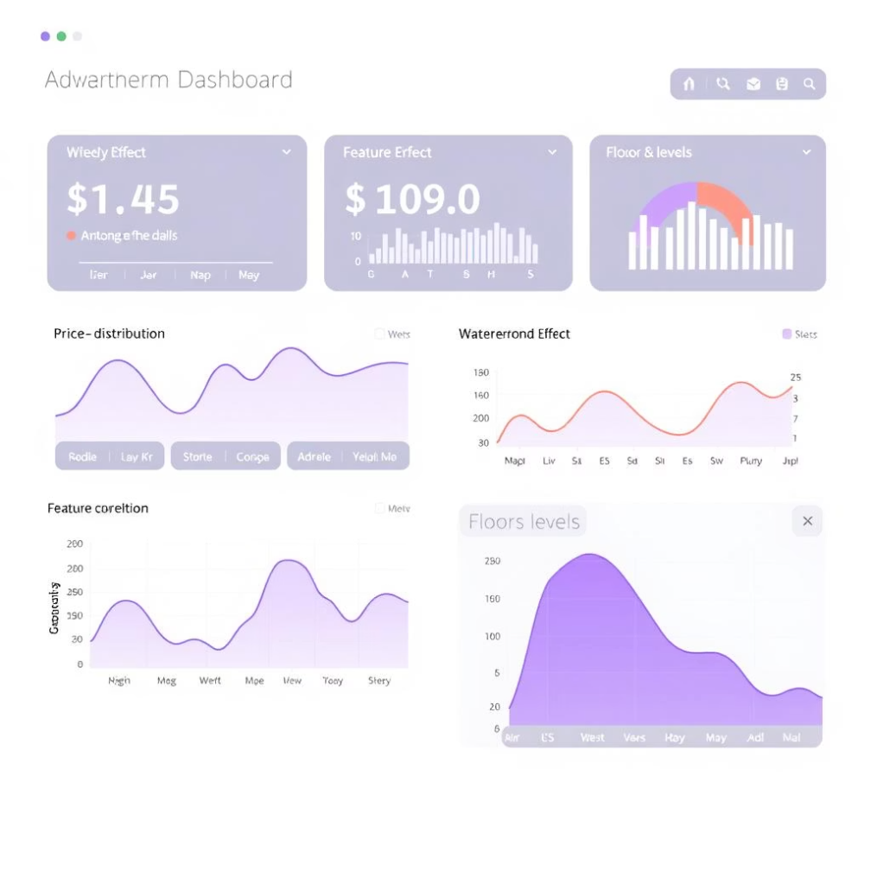
Data Exploration
Price Distribution
Skewed distribution indicates possible outliers.
Waterfront Effect
Boxplot reveals higher prices and more outliers for waterfront houses.
Feature Correlation
sqft_above shows a positive correlation with price.
Floors
Value counts analyzed for unique floor levels in dataset.

Slide 6
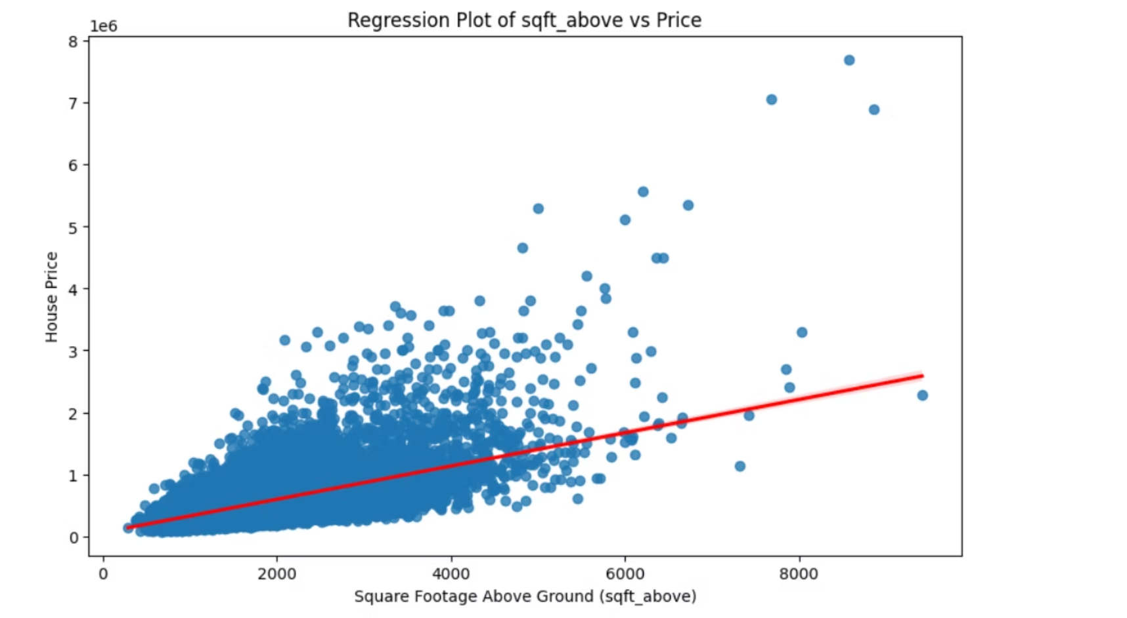

Slide 7

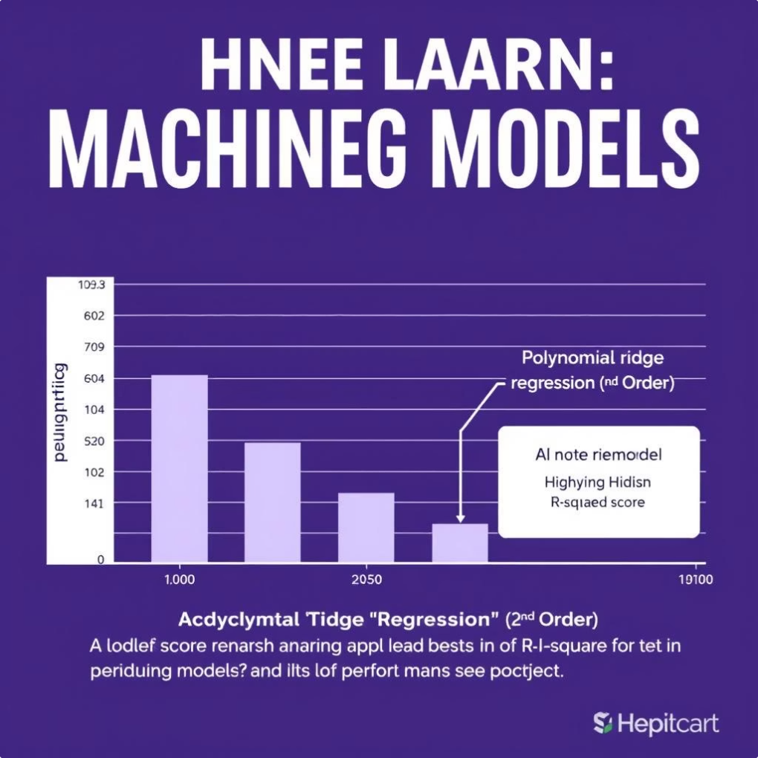
Model Building & Evaluation
Model
Features Used
R² Score
Simple Linear Regression
sqft_living
~0.49
Multiple Linear Regression
11 selected features
~0.70
Pipeline (Polynomial + Scaler + Linear Regression)
11 features
~0.79
Ridge Regression (α=0.1)
11 features
~0.70
Polynomial Ridge Regression (2nd Order)
11 features
~0.84 ✅

Slide 8
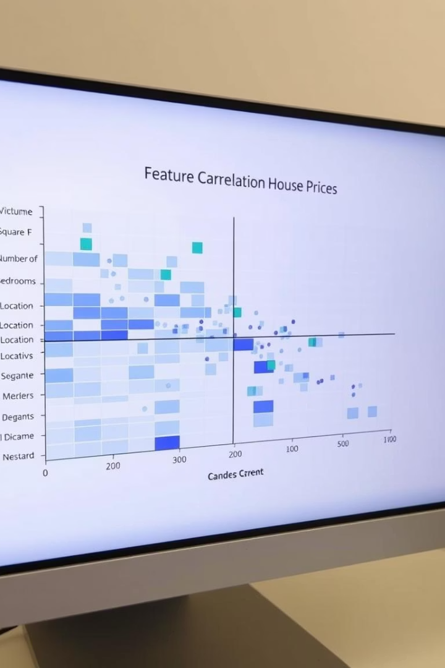
Insights & Findings
Key Features
sqft_living, grade, and latitude strongly correlate with price.
Best Model
Polynomial Ridge Regression achieved highest R² score (~0.84).
Regularisation Benefits
Ridge reduces overfitting and improves generalization.
Pipeline Advantage
Simplifies feature scaling and model training steps.

Slide 9

Conclusion & Learnings
Model Comparison
Built multiple regression models and evaluated their performance.
Data Handling
Handled missing data and leveraged pipelines effectively.
Feature & Preprocessing
Importance of feature selection and preprocessing confirmed.
Future Work
Approach ready for scaling to other housing markets and platforms.

Slide 10
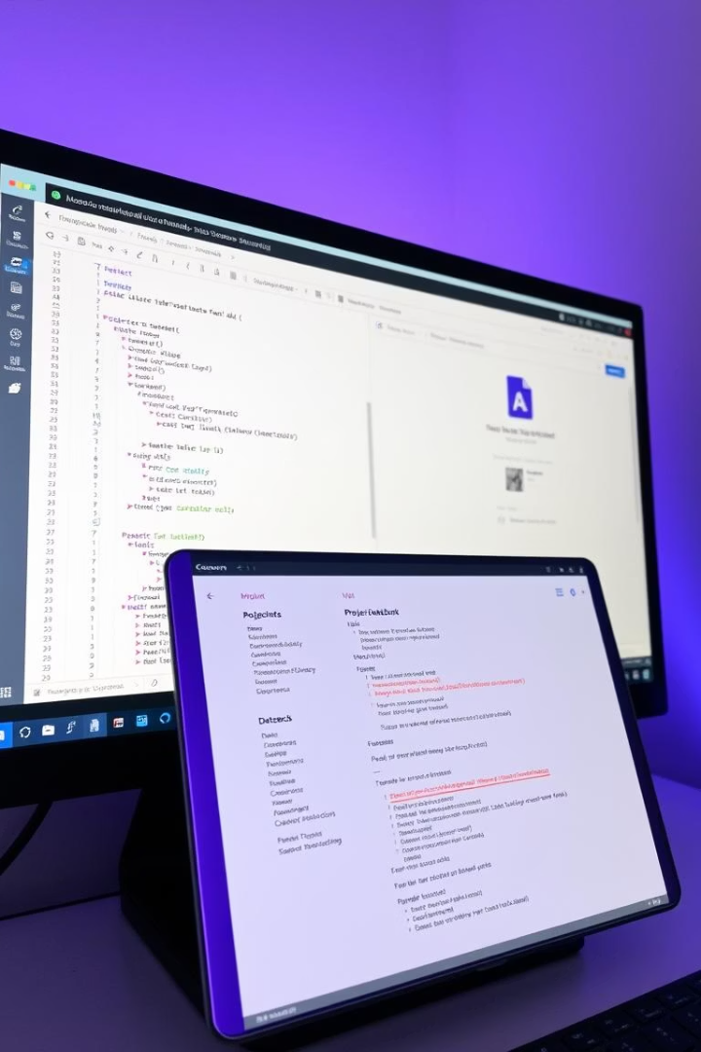

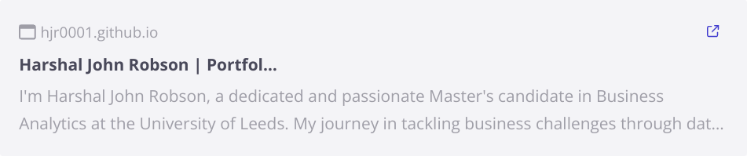
Project Files & Links
Code Notebook
Dataset Source
Access original dataset here: KC House Data CSV
Portfolio Page

